Slide 1

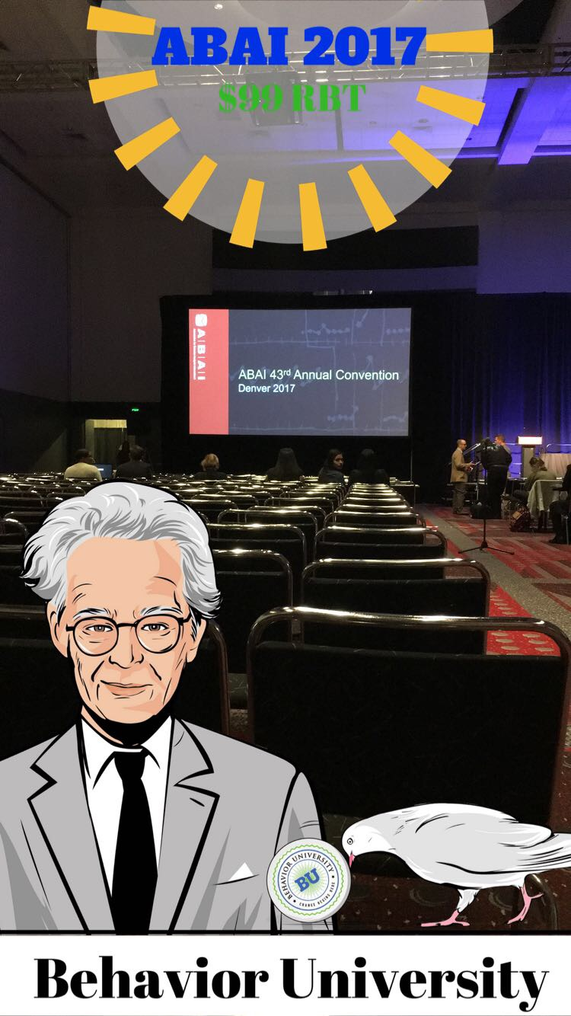
ABAI 2017
By: Liz Lynch

Slide 2
Presentations
Positive Behavior Support (PBS)
Staff Training
  Assists with formation of my thesis

Slide 3
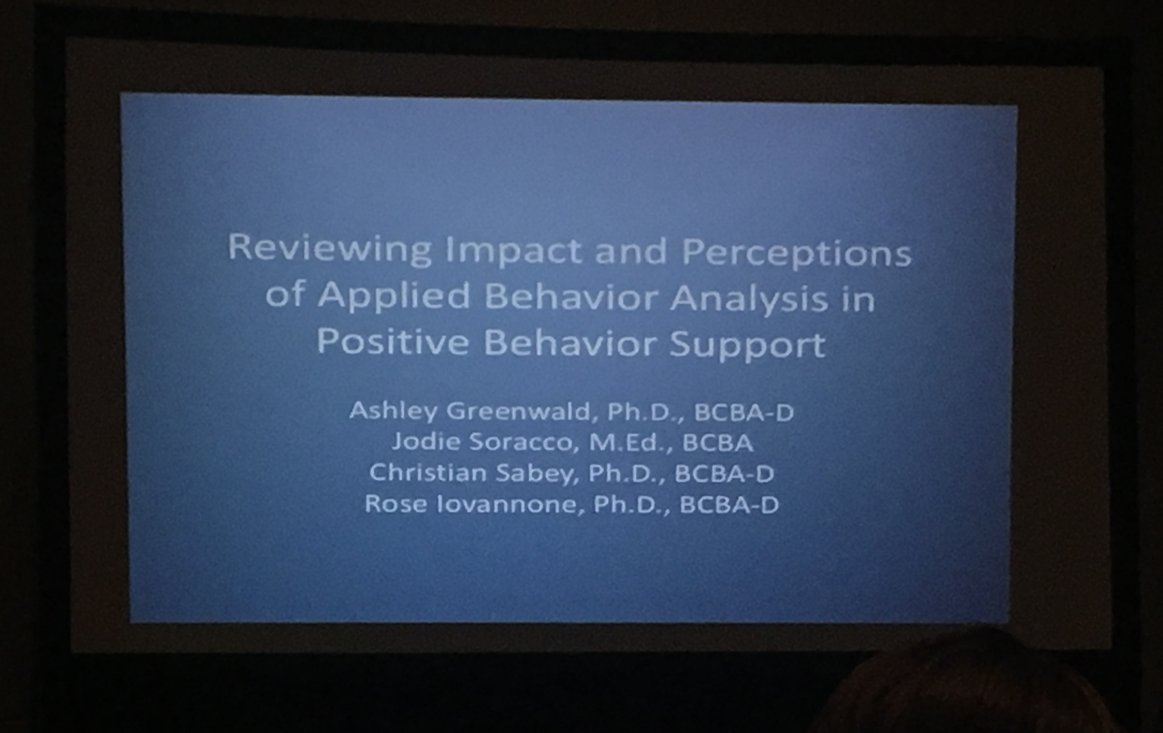

Slide 4
What is PBS?
Evidence-based system change to assist schools in increasing desired academia, safety while decreasing problem behavior of students
  Recent expansion into juvenile detention centers and child welfare, foster care
Create positive school culture
Developed in 80s as a response to aversive punishment and the disability rights movement

Slide 5
Tier 3: Individualized
Tier 2: Supplemental
Tier 1: Universal

Slide 6
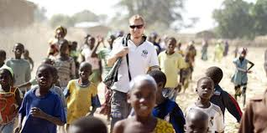
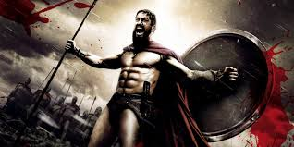
PBS & ABA
PBS |  | ABA
Multi-tiered system Empirically supported strategies Certification to be coach 1980’s | Outcome oriented Evidence-based Common procedures Improve one’s quality of life Behavior analyst should be at all levels (Tier 1, 2, and 3) | Socially significant behaviors 7 Dimensions Course of study 1968

Slide 7
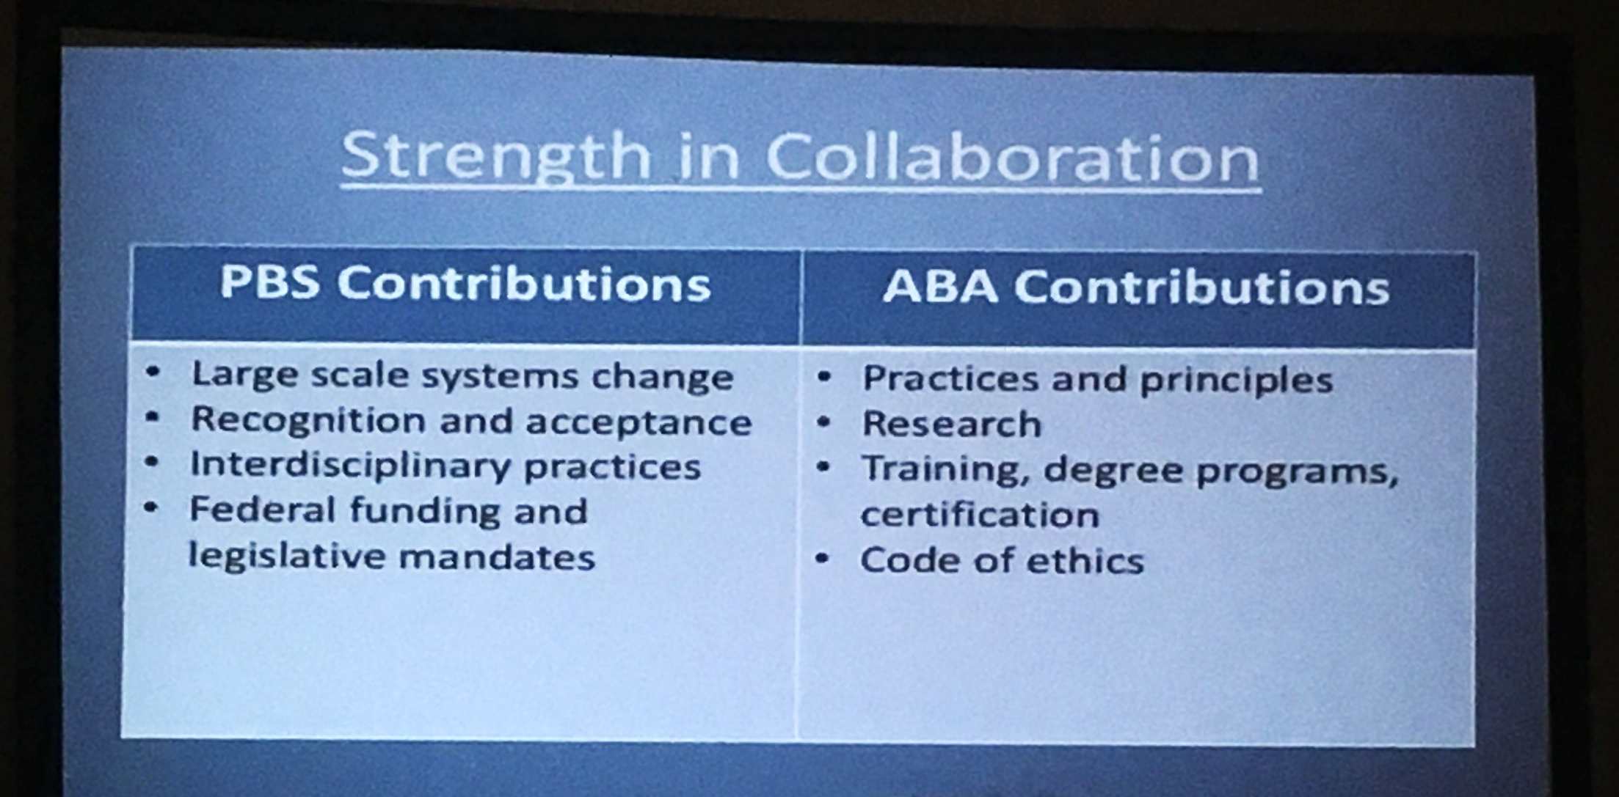

Slide 8
Debunking myths of PBS
Gives teachers just enough to be dangerous | Parent training
No punishment | Error Correction
Threat to ABA | Helps spread ABA
Doesn’t work in all school levels | Individualize for specific school and ANY grade level
Rewarding kids for what their supposed to be doing | Establishes behaviors that provide students with foundational skills and increases their success in school and life

Slide 9
THESIS

Slide 10
Training ABA Skills using Advanced Technology
Interactive Computer Training to train paraprofessionals in self-contained classrooms to correctly implement Discrete Trial Training
Incorporates BST that can be completed online
Teaching checklist -> Remote Performance feedback -> remote in-vivo coaching -> All subjects’ met mastery criterion

Slide 11
Improving Staff Implementation
Implementation of Token Economy with response cost in juvenile Detention Center
Provided Staff token economy manual and quiz
  Summary sheet -> reminders -> meetings -> Staff reached criterion
  Treatment package
Assessment of Needs for Staff

Slide 12
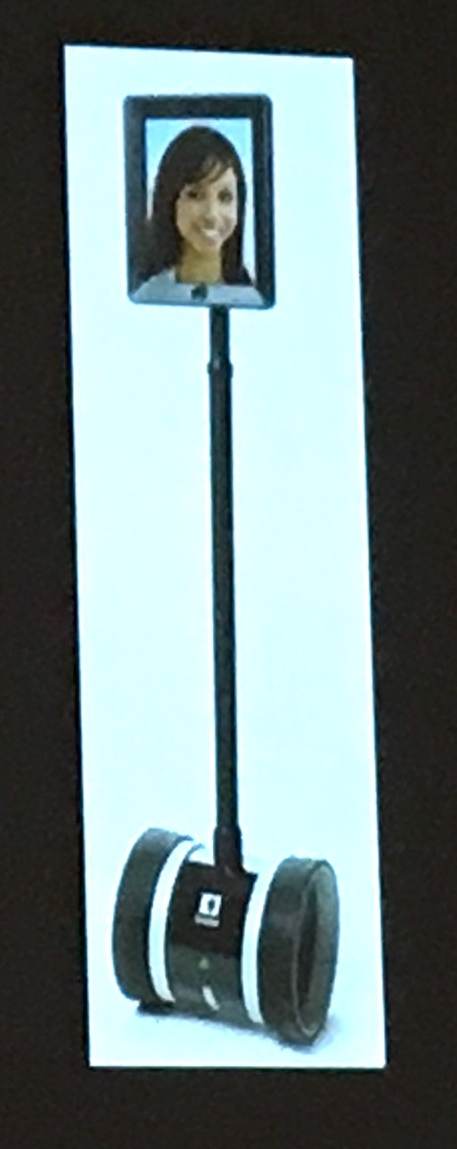
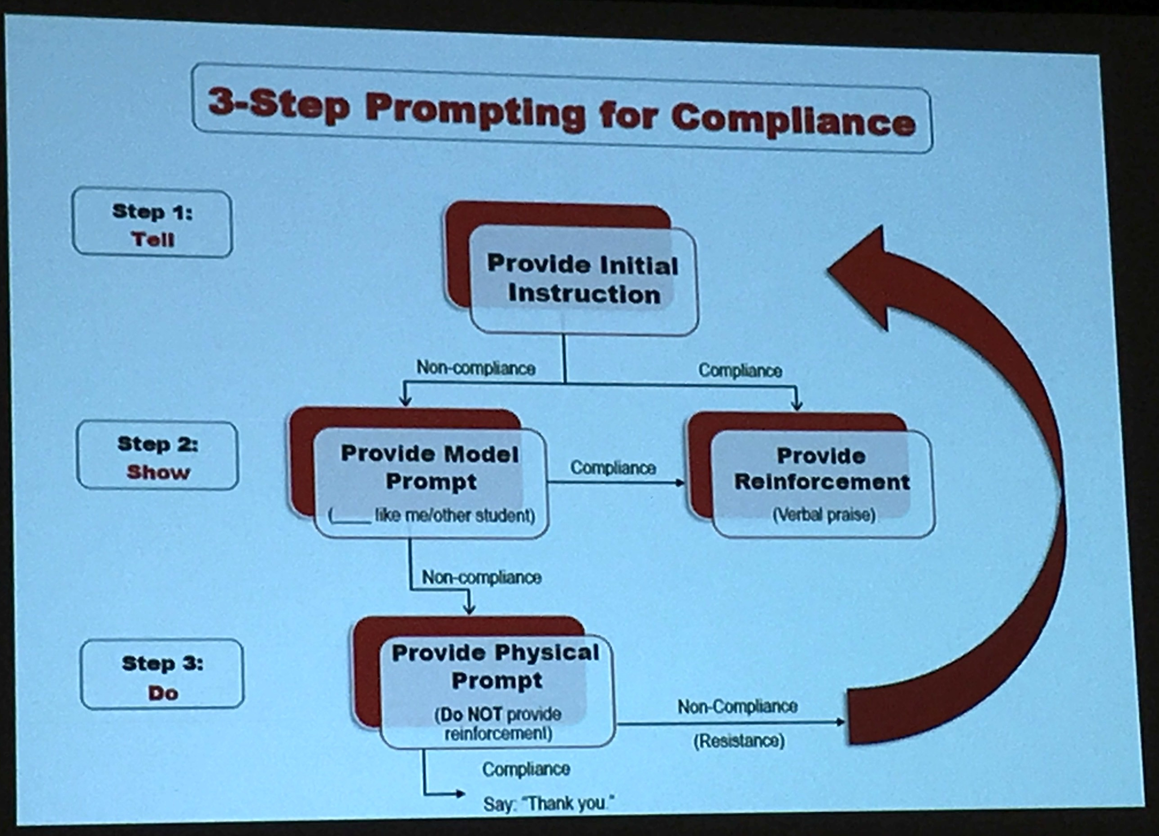
Contextual Issues in Staff Training
Possible solution to staff consultation and increasing fidelity of intervention implementation
Teleconsultation to train staff in classrooms on three-step prompting
  BST format
Teachers reached criterion
High Social Acceptability Ratings

Slide 13
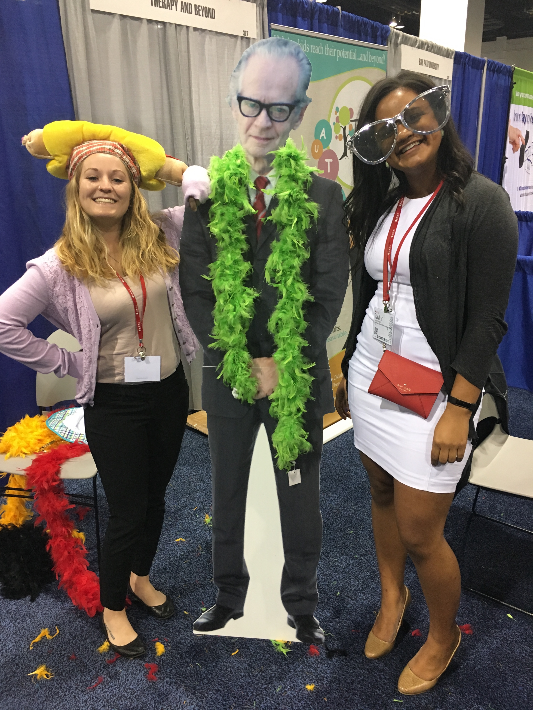
Take Away
Bigger market and acceptance when combine with PBS
  We have same goal
  PBS helps with ABA movement
Problems with staff training
Technology
Thank you!

